Slide 1

Better Public Services Supporting Life Events with Digital Services
Tony Shannon
Head of Digital Services
Office of Government Chief Information Officer
Department of Public Expenditure, NDP Delivery and Reform

Slide 2


Slide 3

Stories from the Frontline

Slide 4


Digital and Innovation at Scale
The Public Service will work together to
Tackle big societal issues and drive societal change
Achieve a seamless user experience and inclusive service delivery
Provide a dynamic and agile workplace
A Public Service that:
Builds trust in public institutions
Focuses on outcomes
Delivers climate action and sustainability

Slide 5

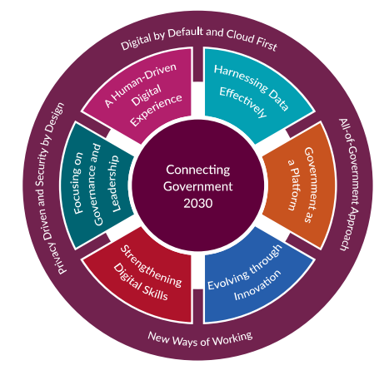

Slide 6

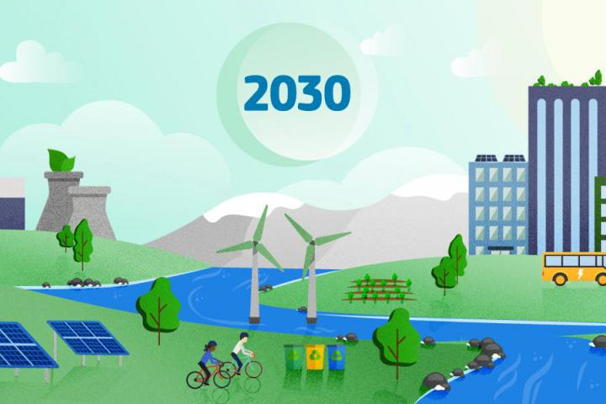
Towards 2030: Decade of Digital & Green
9

Slide 7

Why?

Slide 8
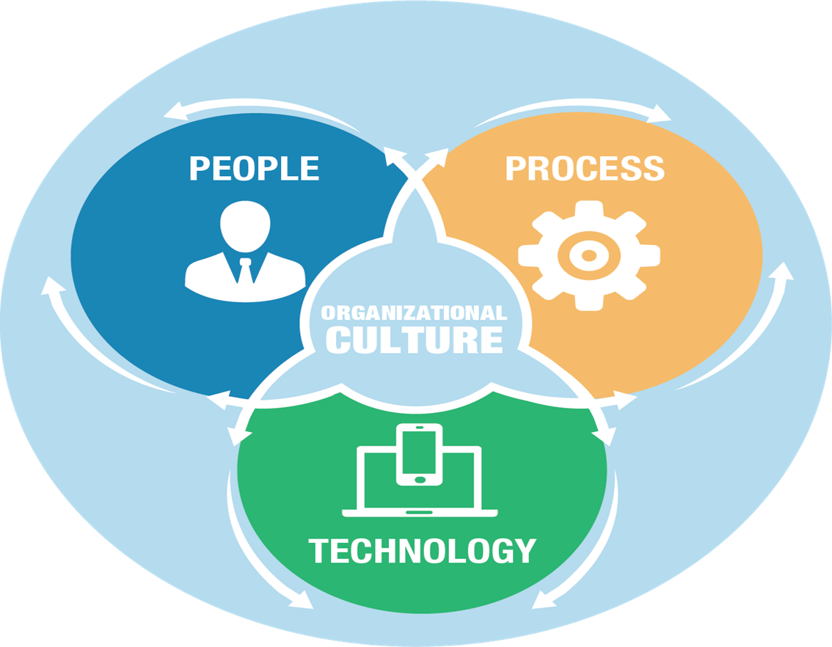
How?

Slide 9

What?

Slide 10
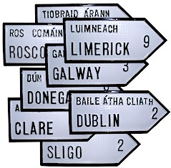
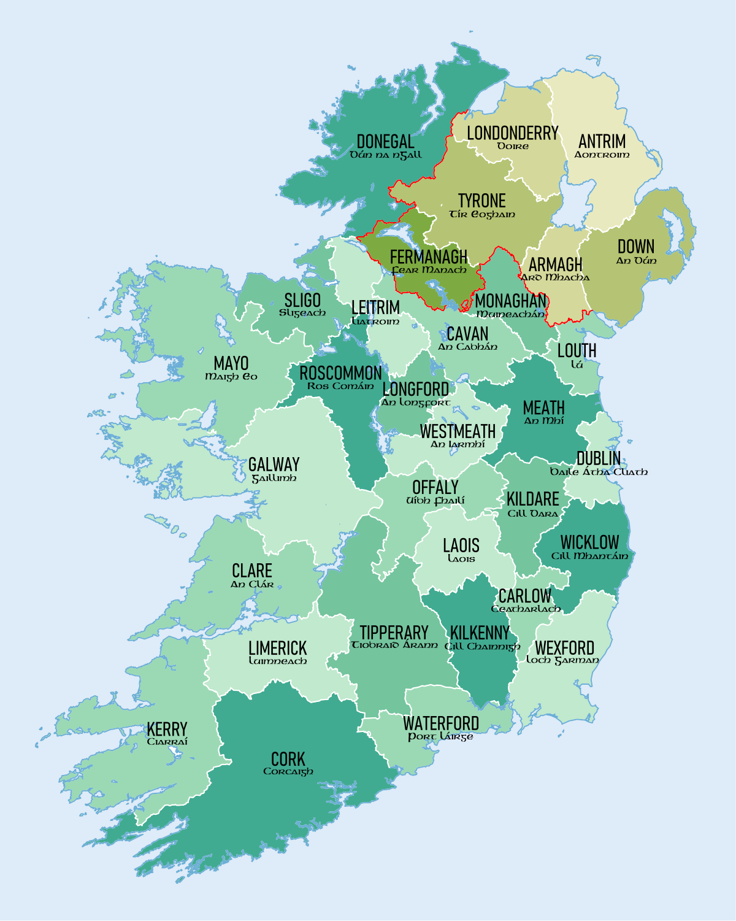
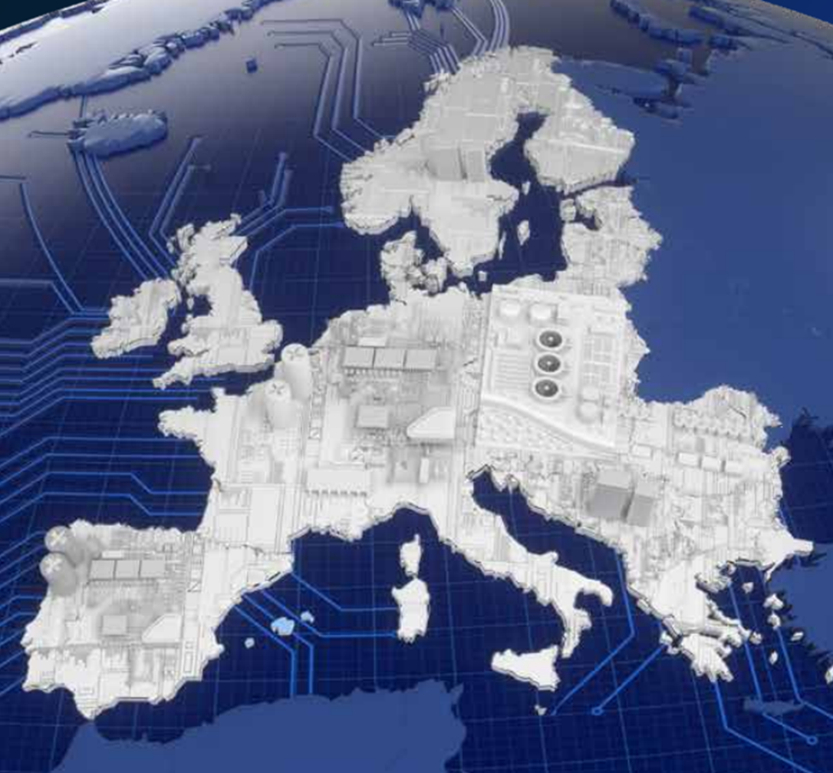
Where?

Slide 11


When?

Slide 13
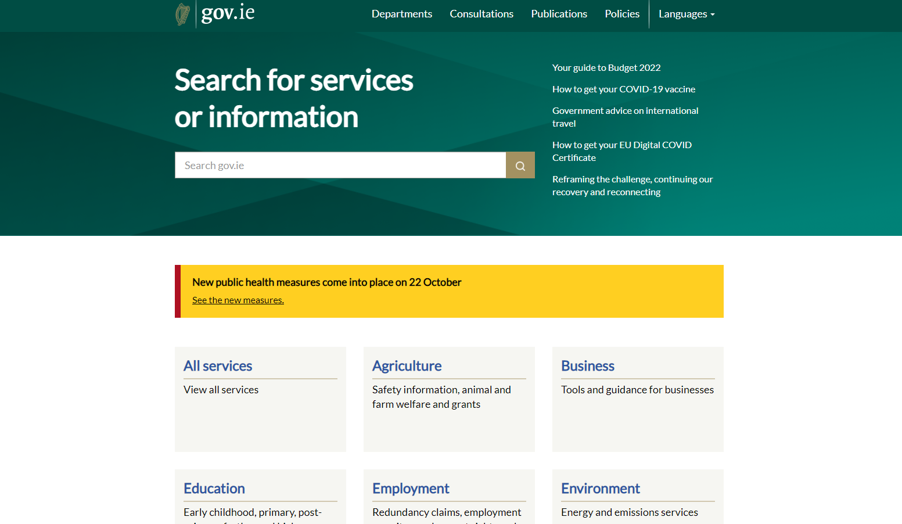
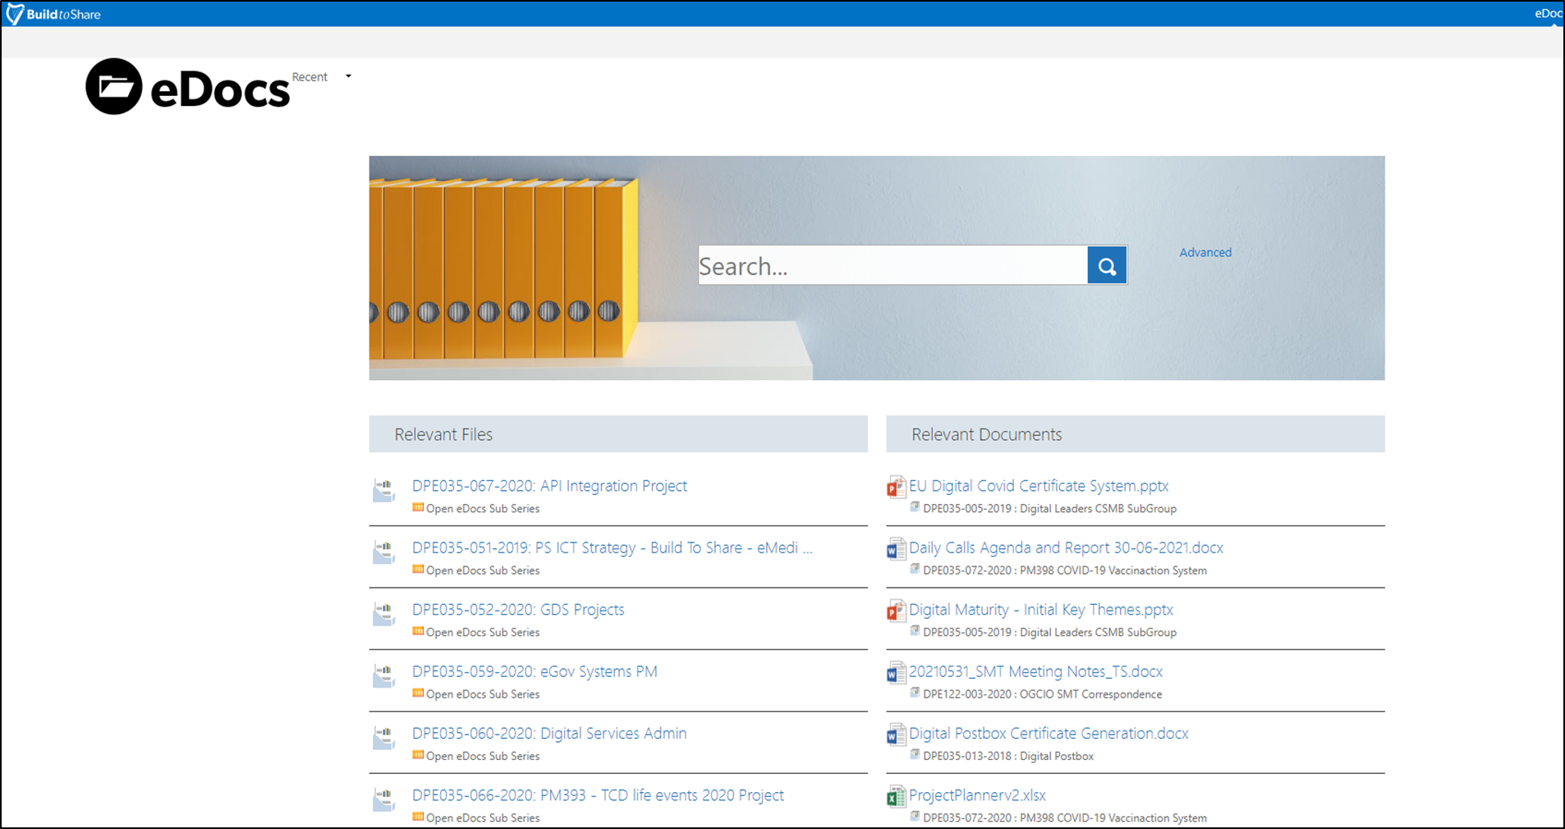


Slide 14
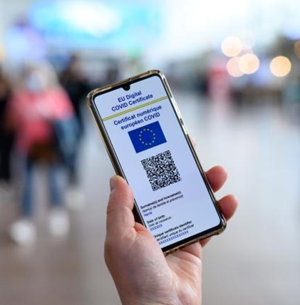
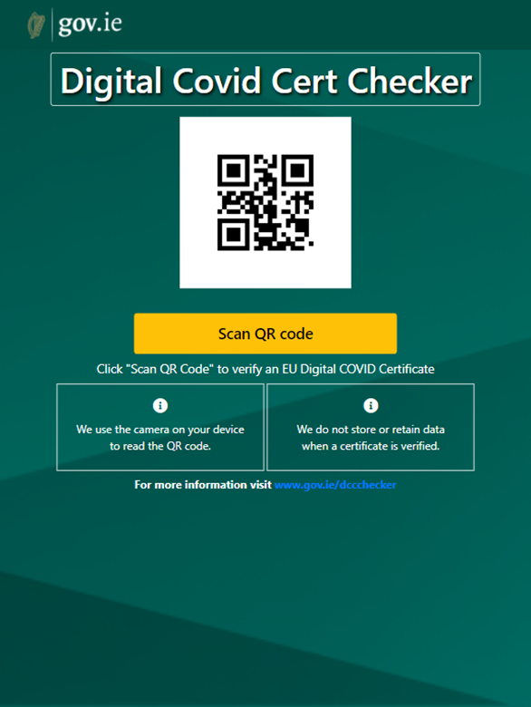

Slide 15



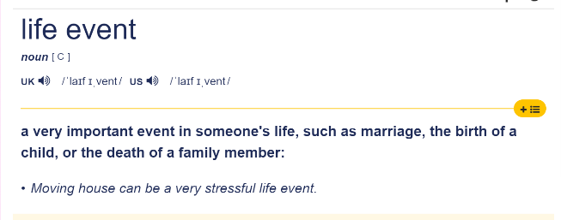


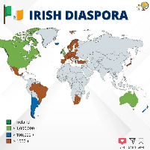



Slide 16
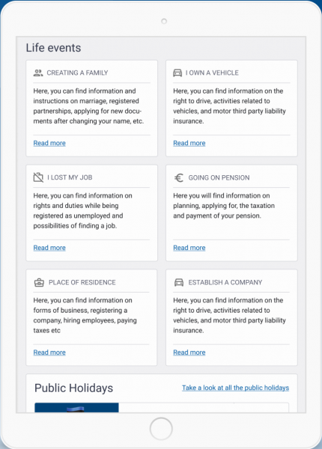
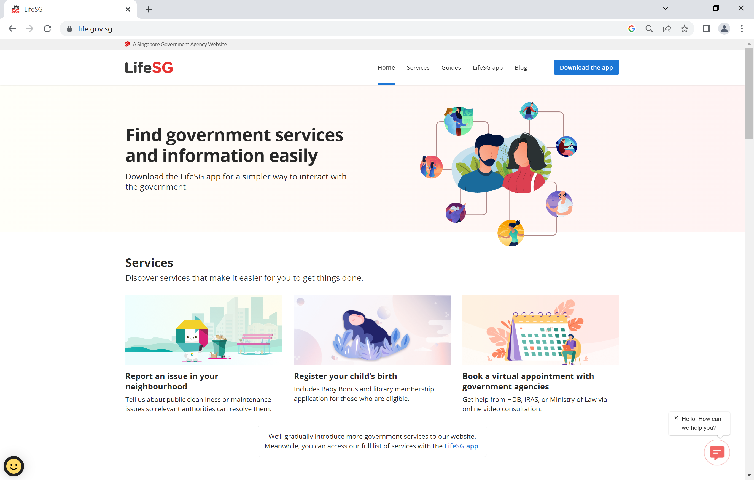
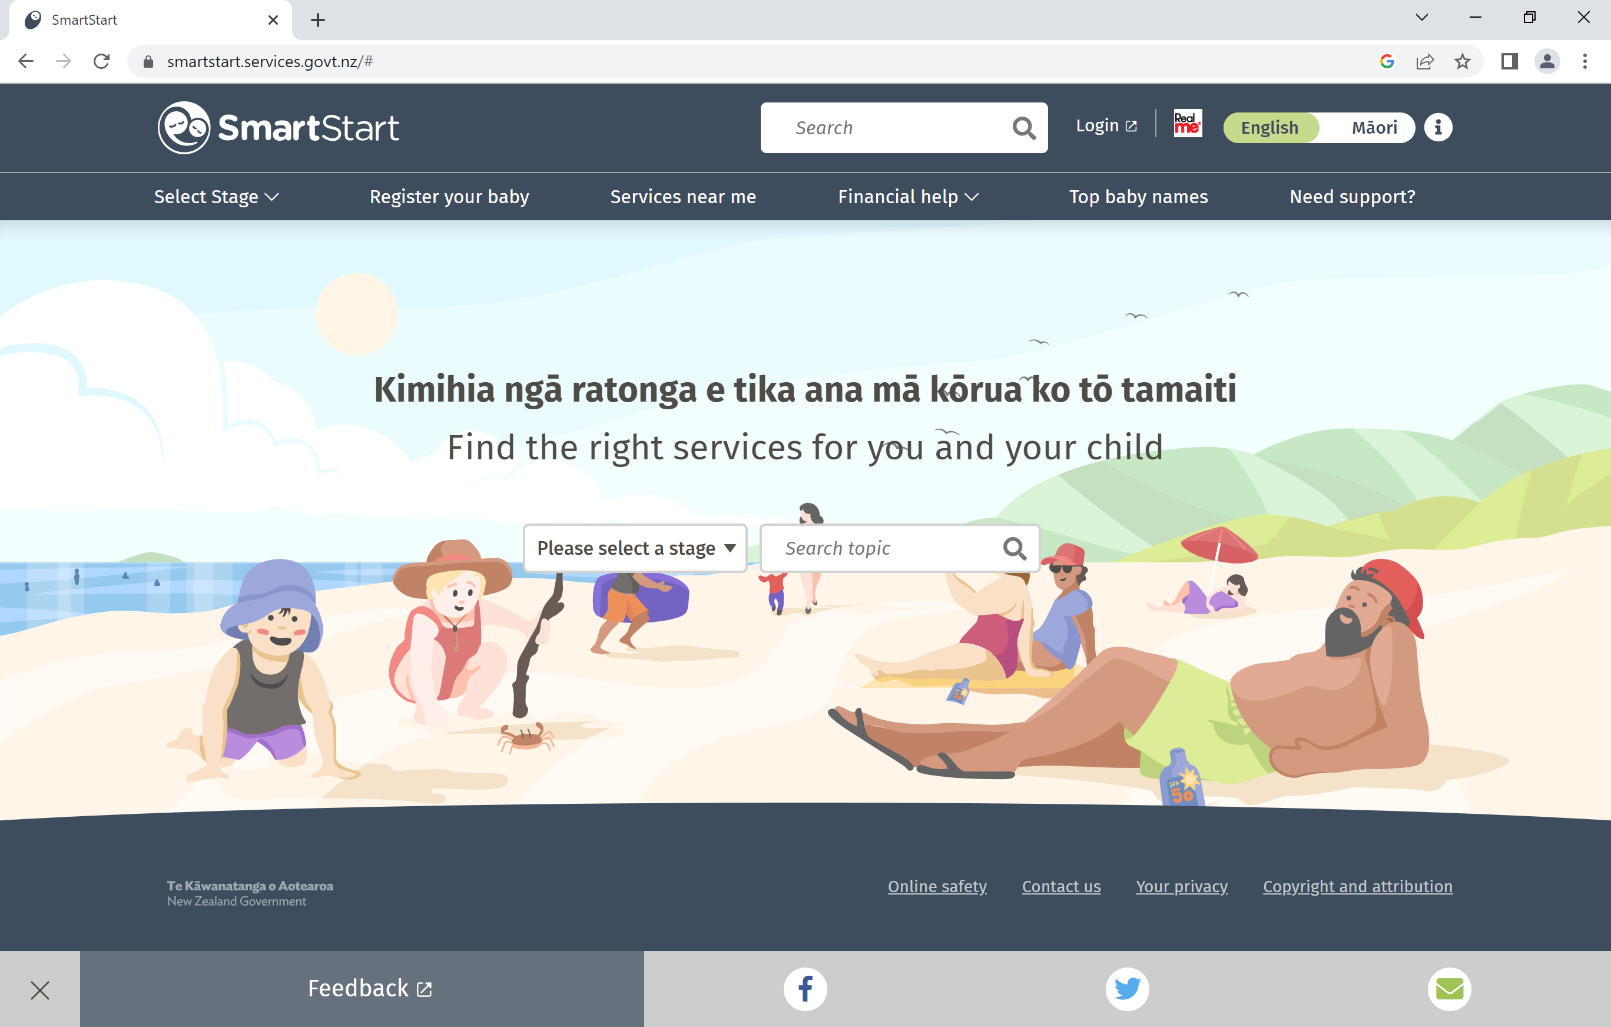
Life Events - Digital Services
Estonia
Singapore
Estonia
New Zealand

Slide 18

People - User Centred Design

Slide 19
Design Principles
We will put
people first
We will design services together
We will design so knowledge can be reused
& shared
Principle 01/
Principle 03/
Principle 05/
We will design
to be inclusive
We will design for trust
Principle 02/
Principle 04/
We will challenge assumptions
& design
with evidence
We will design to deliver value - in all its forms
We will work
to make
things simpler
Principle 06/
Principle 08/
Principle 10/
We will design from the top down & the bottom up
We will build, test, learn & iterate
Principle 07/
Principle 09/

Slide 20
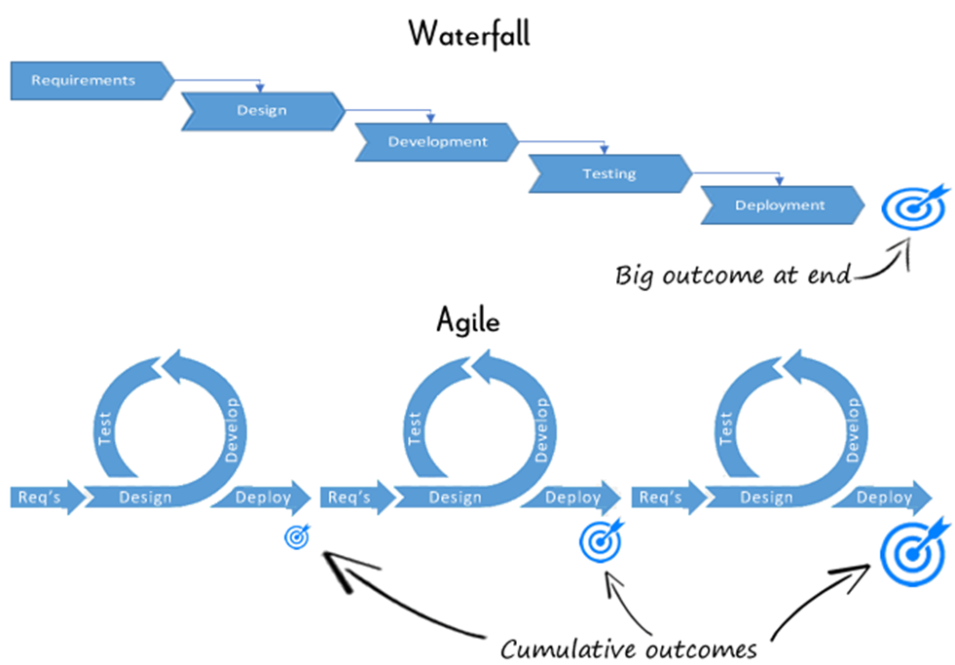
Process- Agile & Iterative
People - User Centred Design

Slide 21



Technology – Building Blocks- Open

Slide 22
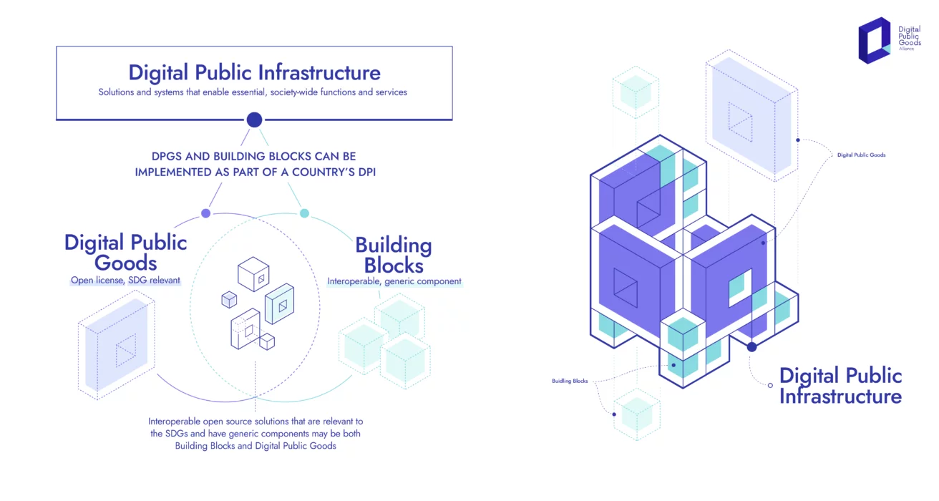
Technology – Building Blocks- Open

Slide 23
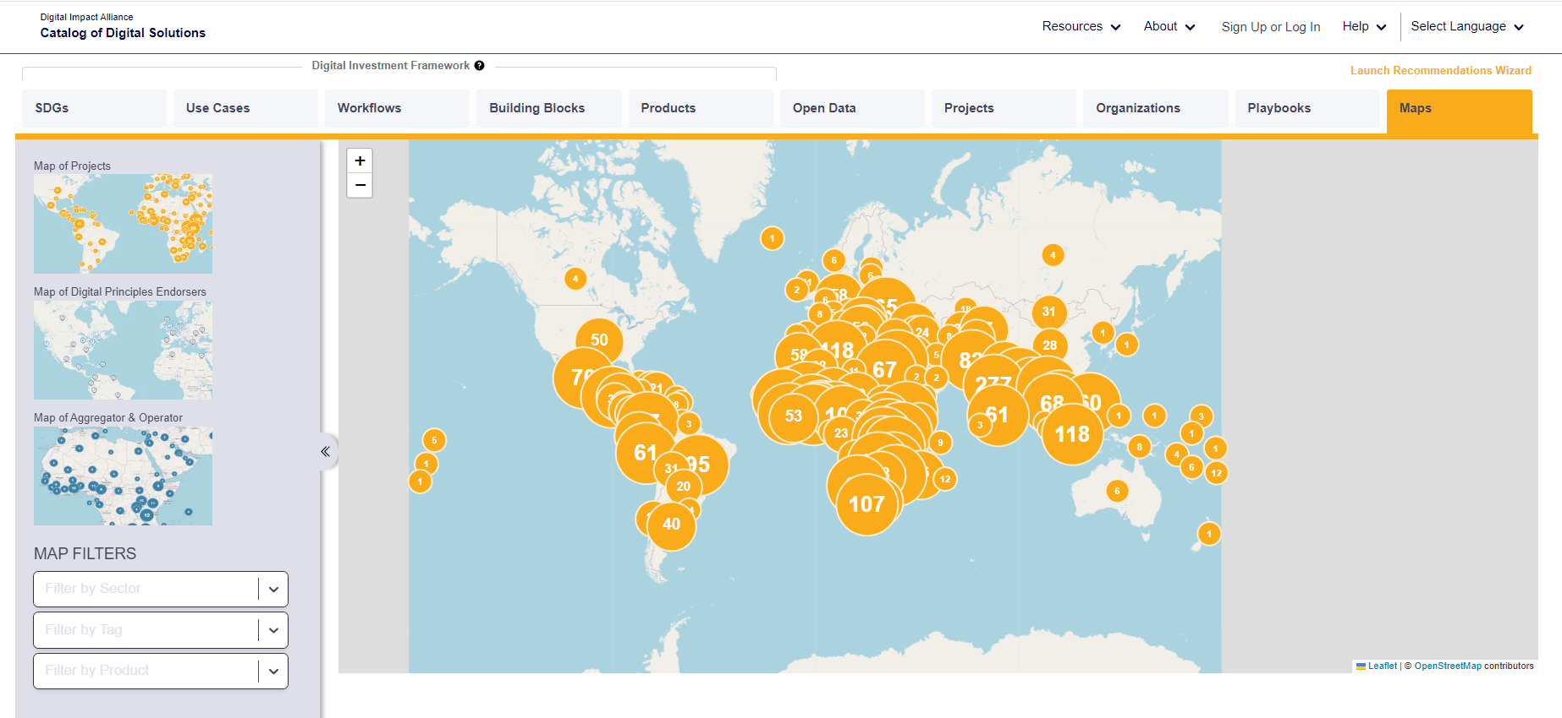
Towards a Digital Commons

Slide 24
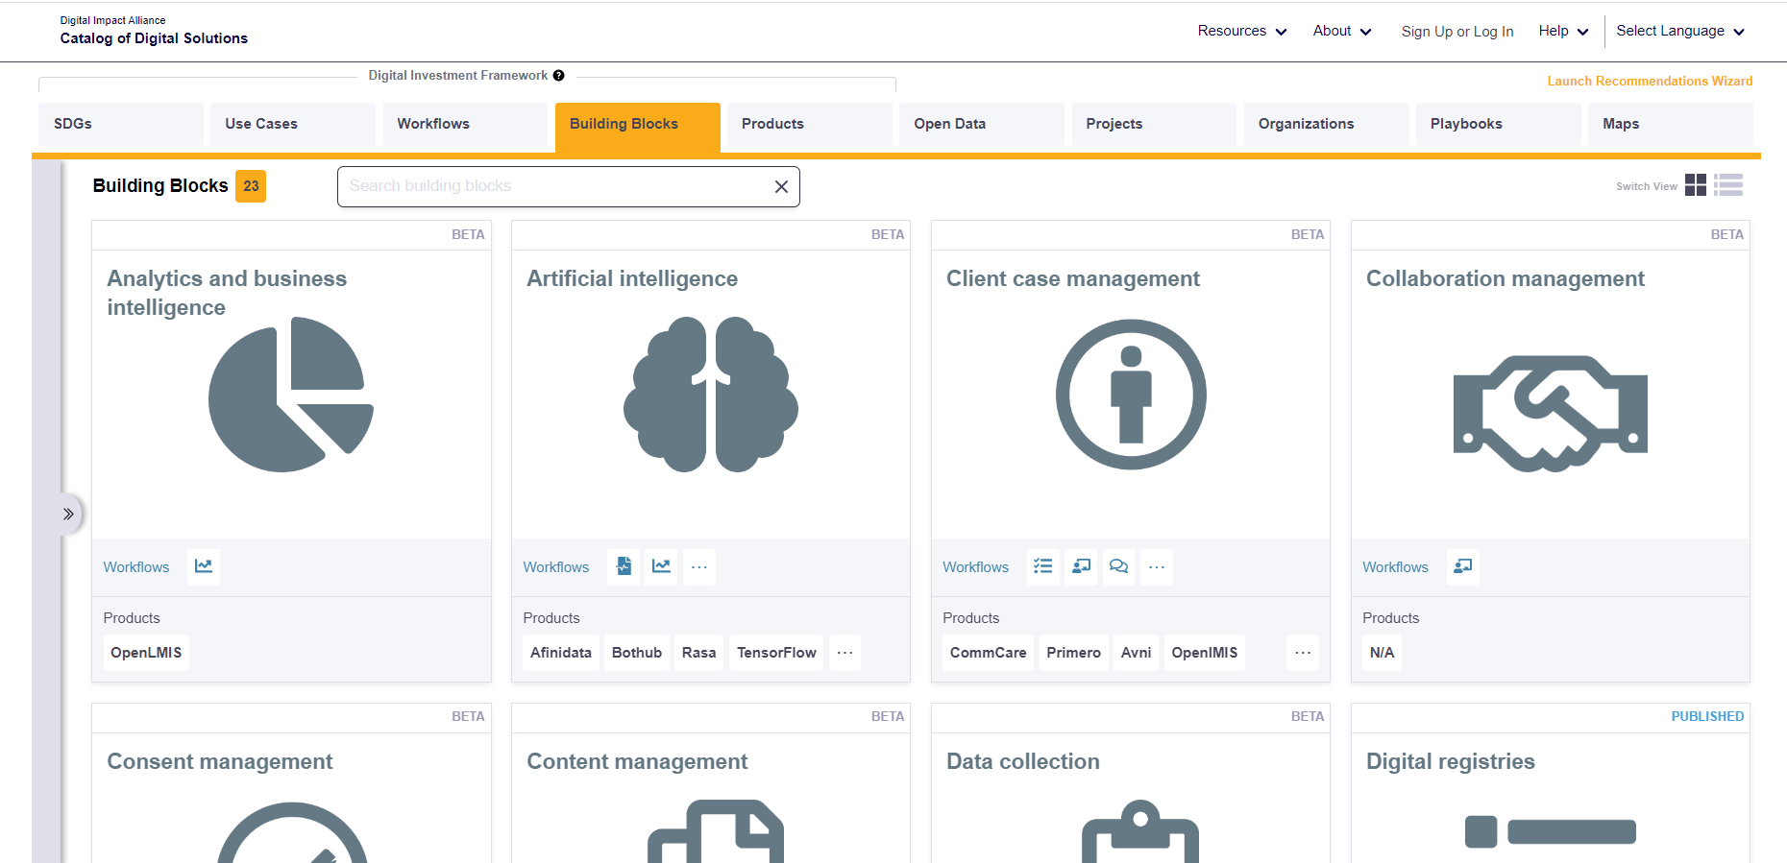

Components in the Commons

Slide 25
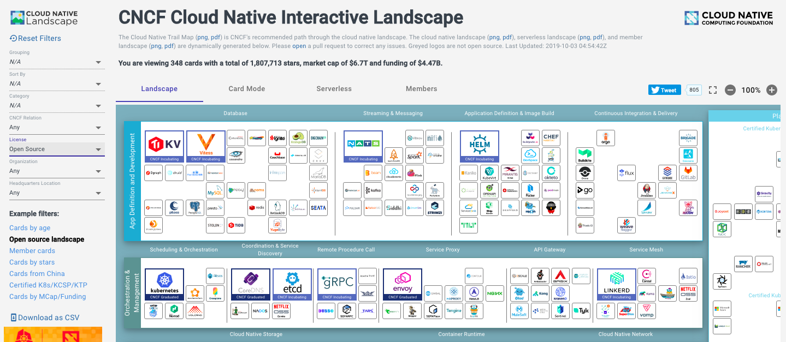


Components in the Cloud
Ripple Foundation C.I.C Ltd
Private & Confidential

Slide 26

Life Events Service / Once Only Principle
Design System
Content Management – gov.ie
Digital Identity - MyGovID
Data Collection- eforms
Case Management – eCase
Messaging - DigPostBox
Digital Wallet

Slide 27
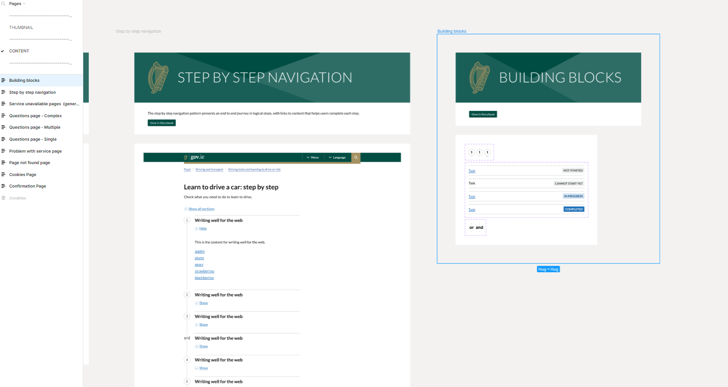
Design System

Slide 28
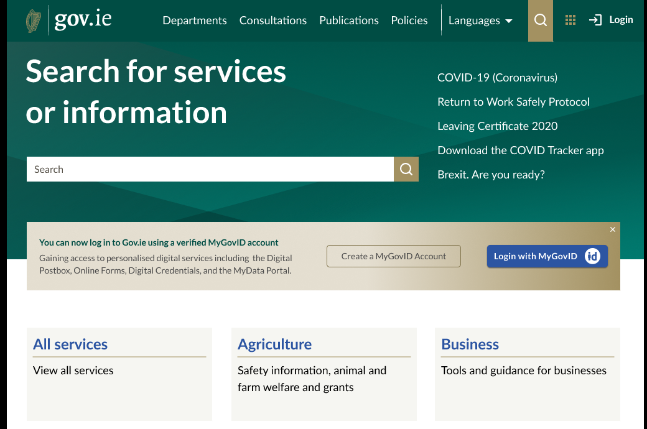
Content Management

Slide 29
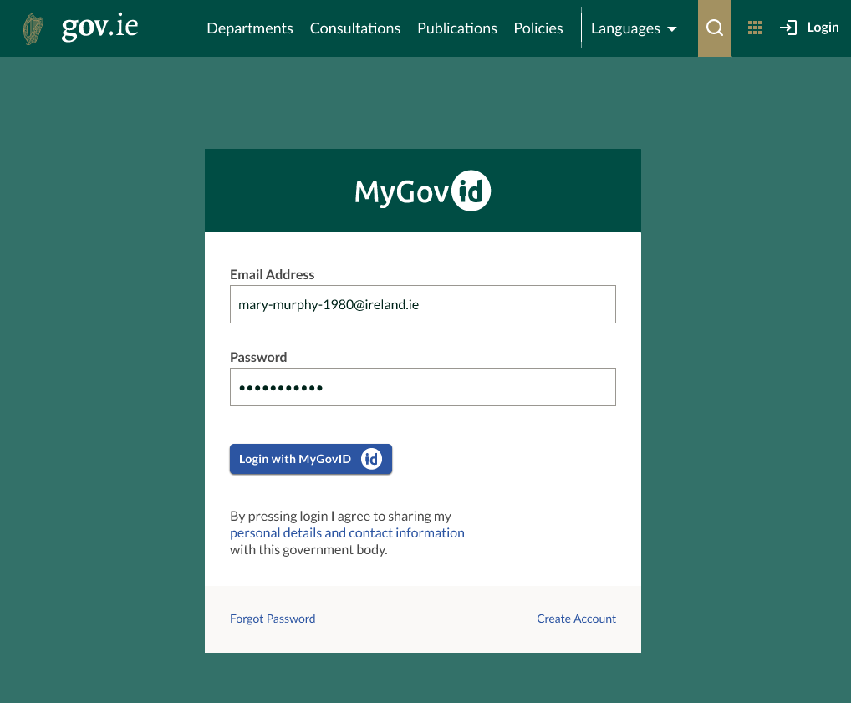
Digital Identity

Slide 30
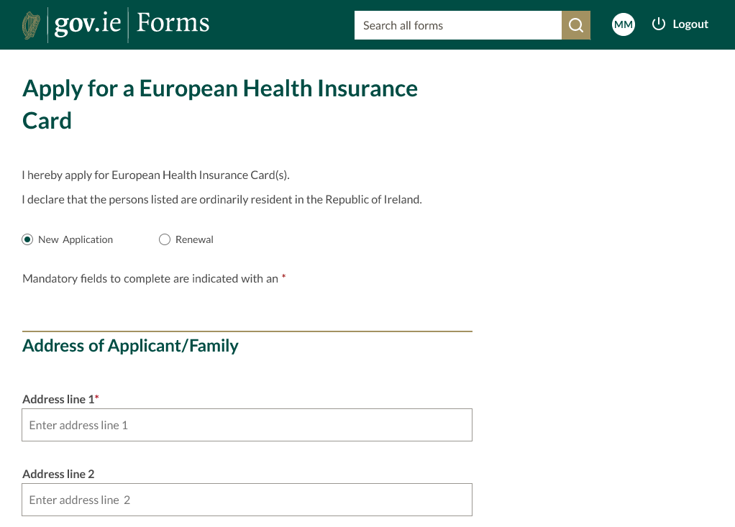
Data Collection

Slide 31
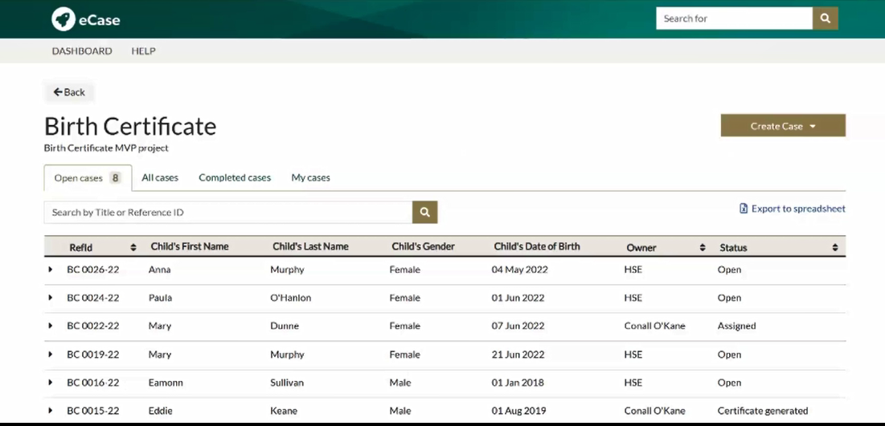
Case Management

Slide 32
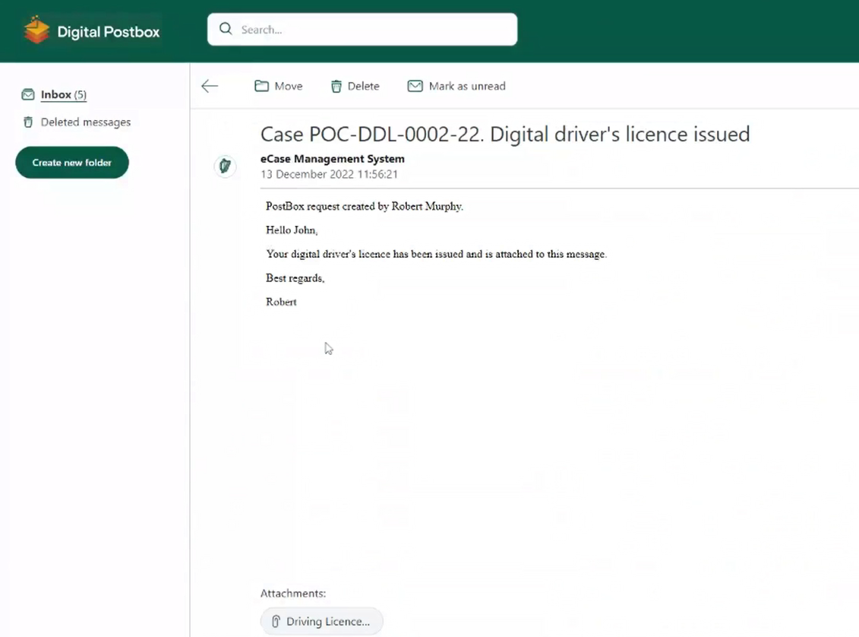
Messaging

Slide 33
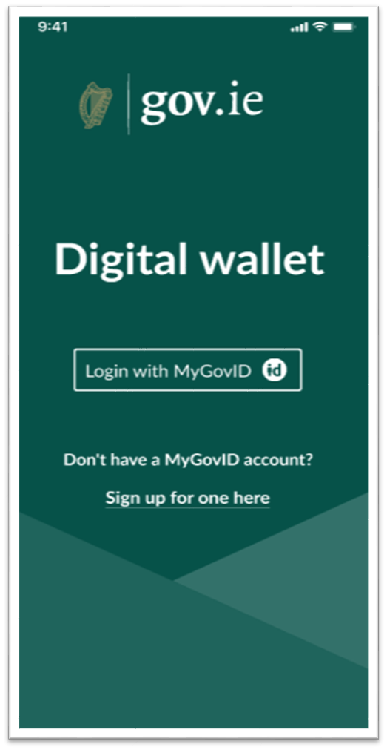

Life Events - Digital Wallet

Slide 34
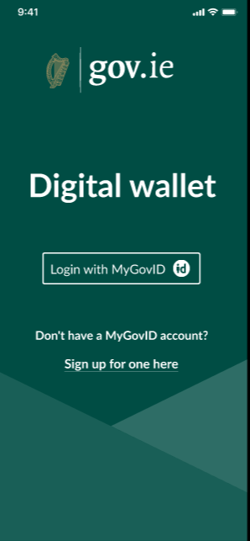
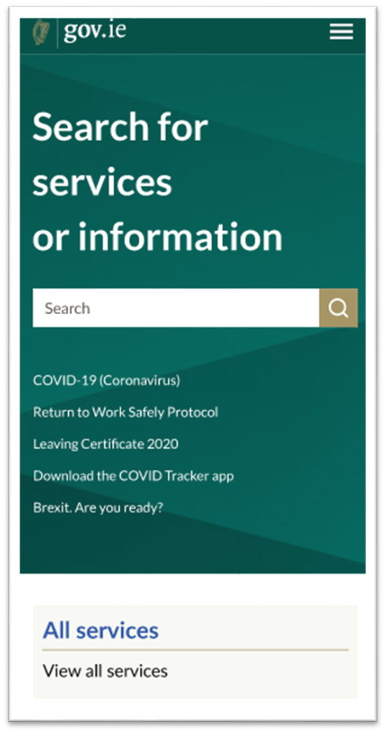
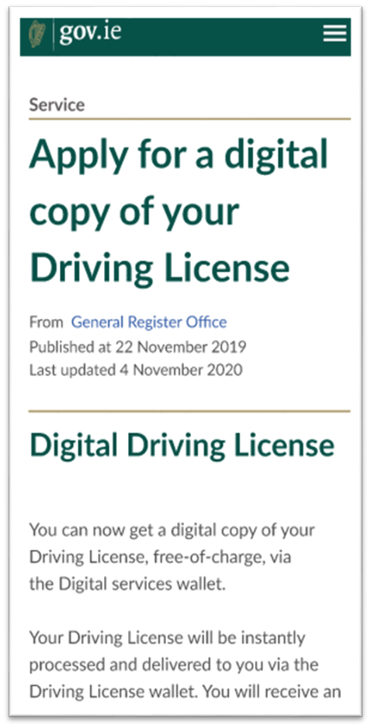

Slide 35
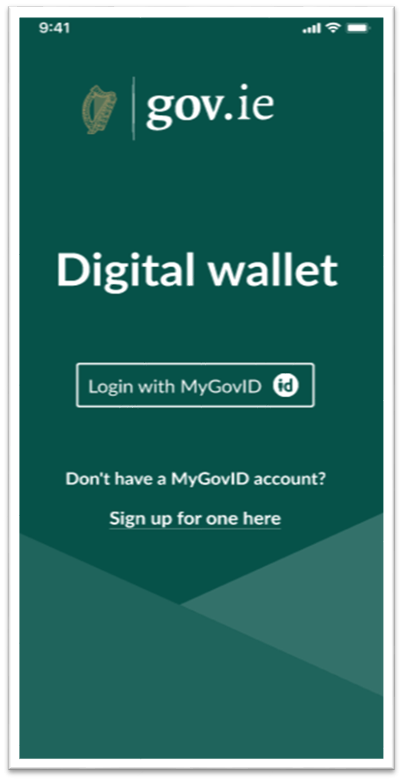
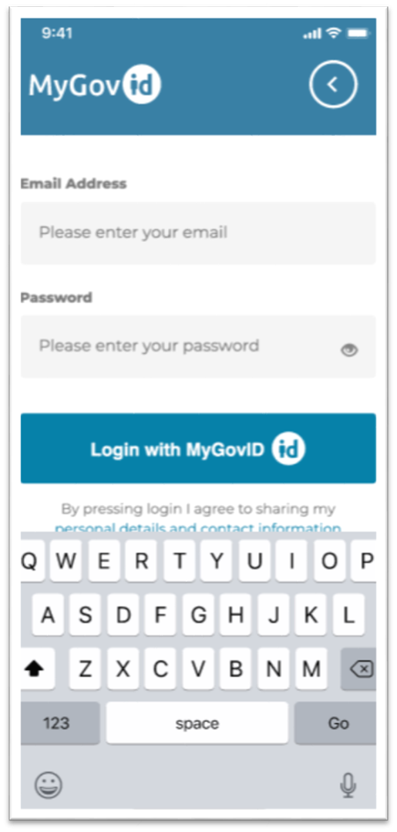
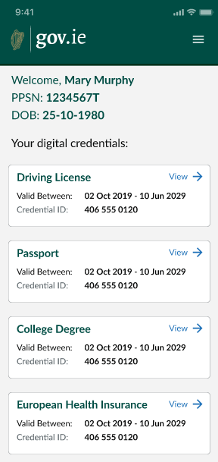

Slide 36
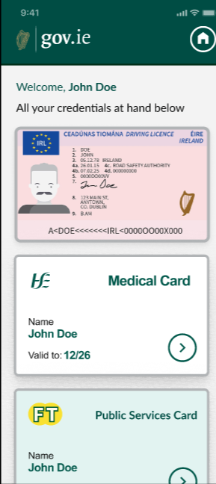
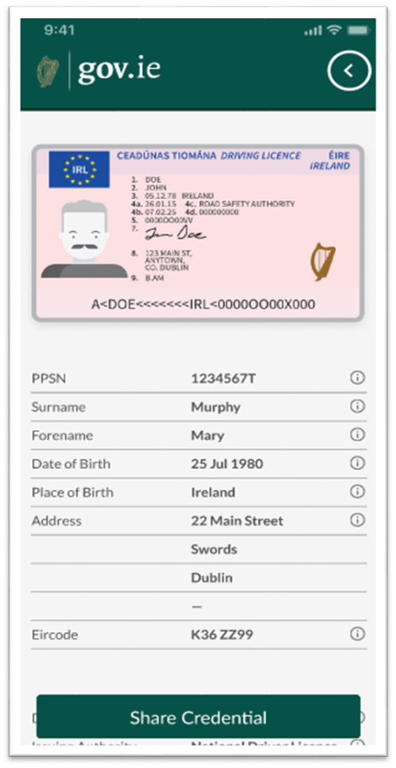
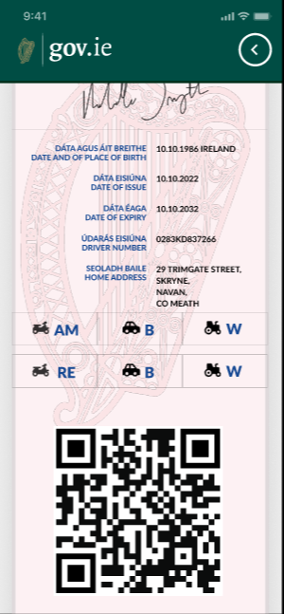

Slide 38

Challenge

Slide 39

Opportunity

Slide 41
Thank You

Slide 42
Links to related Prototypes
Life Events to Digital Wallet - Gov/Public Sector/National Level - Mockup
https://www.figma.com/proto/fLBdoyqpbXLCheeikYRNXE/Digital-Wallet---Gov.ie---POC?page-id=249%3A11712&type=design&node-id=296-27100&viewport=8821%2C2497%2C0.25&t=Bc0Vznia2Q7MTsTv-1&scaling=min-zoom&starting-point-node-id=296%3A27100
Life Events to Digital Wallet - Gov/Public Sector to citizen share to EU/Private Sector - Mockup
https://www.figma.com/proto/fLBdoyqpbXLCheeikYRNXE/Digital-Wallet---Gov.ie---POC?page-id=293%3A26847&type=design&node-id=296-26771&viewport=15358%2C4560%2C0.5&t=EBmEDX8XqD17nf9M-1&scaling=min-zoom&starting-point-node-id=293%3A27488&show-proto-sidebar=1
Life Events – Digital Wallet Pilot 2023 Nov
https://www.figma.com/proto/fLBdoyqpbXLCheeikYRNXE/Digital-Wallet---Gov.ie---POC?type=design&node-id=1712-77989&t=KfJMqE2Hsb8mh4Aw-0&scaling=scale-down&page-id=1063%3A29910&starting-point-node-id=1674%3A73668

